Slide 1
Writing for and maintaining a blog: An interactive workshop
Ravi Parikh
MD/MPP Candidate

Slide 2
Todays Discussion
What we WILL cover
What we WON’T cover
Why and why not to blog
Finding the right blog to write for
Understanding your audience
The importance of sustaining a regular schedule
How to START your own blog
Hosting
Software
Themes

Slide 3
Quick aside on using WordPress
Take a look at Shorenstein Center Communications Program website: “How to Launch Your Own Website Using WordPress” by Ken Gagne
http://snipurl.com/wp-hks
Improving cyber-security
http://blogs.computerworld.com/cybercrime-an-hacking/20857/securing-wordpress-against-hacks
E-commerce and Paypal
http://wordpress.org/extend/plugins/wordpress-simple-paypal-shopping-cart/

Slide 4
Your Turn!
Name
Why do you want to blog?
Where do you want to blog?
Blogging/writing experience?
What do you want to get out of this workshop?

Slide 5
Finding the Right Blog
What are you trying to do?
National vs. Local Audience
Guest blogger vs. staff
Engagement
Comments
Retweets
Shares
$$$
Largest database of blogs: www.technorati.com
Notes:
[1] Determine goals and key performance indicators (KPIs)
Success in anything, but especially in guest blogging, starts with identifying goals. What are you trying to accomplish? What are you expecting to gain from it? And, also very significant: How will you measure success?
Let's say I'm looking for blogging opportunities. There are three things that I would like to accomplish:
Become part of new communities and build relationships with people outside of SEO. (Not that there's anything wrong with SEOs. It's just an example, folks. Carry on).
- Attract business that is a match for Mack Web's culture and values. - Find new information sources (blogs) where I can learn, teach the team, and better serve our clients. - I would measure success in connections made, qualified leads generated, and new quality blogs to read.
When you guest blog, you've been provided the opportunity to leverage someone else's audience, someone else's brand, and someone else's established forum. That means, if you're doing it right, guest blogging should be some of your best work. Think of it as a speaking engagement. You wouldn't get up in front of a group of people unprepared. You would take the time to carefully craft your message in order to make the biggest impact on your audience.
Read more: http://wallblog.co.uk/2012/10/26/turning-seo-link-building-into-seo-audience-targeting-with-twitter-profiling/#ixzz2hcdISbqx Follow us: @brandrepublic on Twitter
Ultimately, if your guest blogging is a success, you will attract customers from this blog to your website and blog. So, most importantly, you've got to make sure the people who are part of this community are in alignment with your brand.
Go read the entries on the blog. Is the content of good quality? Do the posts resonate with your philosophies? Are the other contributors to this blog reputable? Would you hang out with them? If you were to guest on this blog, would it speak well of your brand? Are you going to want any of their readers as your customers? Would you spend time with their community?
Here’s how to find good-paying blogging clients and get them to hire you:
1. Make your blog posts awesome and engaging. Even if there are only a few posts on there, make them great — concise and focused on your niche. Think of your blog as a rolling audition for paying gigs. In my experience, paying blog clients want to see three things: that you know how to get comments, stick to a niche topic, and use common blogging platforms such as WordPress and Blogger.
2. Select your targets. Consider where you might likely blog for pay, based on your own interests and work experience. For instance, I was once a legal secretary, so I’ve done some paid blogs for lawyers. Develop a list of publications, companies, or Web portals that might hire you and pay well. Don’t ignore trade publications, as they are often good payers. Once you’ve got some possible prospects, take a look at their websites to see if they lack a blog, or perhaps have a blog that’s short on visitors and infrequently updated.
3. Research your targets. Next, do some sleuthing to discover who might pay well. In general, I find more sophisticated topics and target audiences command better pay and have less writer competition. So blogging about parenting or your dog will not pay well, but writing about acupuncture or business finance likely will. Next, find out if the publication is growing or the company is well-funded. Writers’ groups on LinkedIn are a great place to ask around about a prospective employer. In general, bigger companies will offer better pay.
4. Promote your blog posts in social media. Start spreading your content around. Connect with popular users of social media in the niche where you want to blog for pay.
5. Target prospects with your posts. When you have a post that makes a good audition piece, send it to your prospects (or top social-media influencers) with a note: “I thought you’d enjoy this post.” You can use Twitter, LinkedIn, or just plain email — whatever you think that prospect would respond to best. Even better: Write a post for your blog specifically tailored to appeal to your prospects, then send it to them.
6. Leave comments on key blogs. Another way to connect with well-paying blogs is to leave articulate comments on that blog. Become a regular participant and link to your own blog posts. You may get read, discovered and offered a paying gig.
7. Call on prospects and ask for the job. If the steps above haven’t gotten you asked to blog for pay, it’s time to get proactive. You might call editors and marketing managers on the phone and ask if they need a blogger, send postcards, or perhaps use InMail on LinkedIn (that last boasts an impressive 30% response rate). Experiment and see what works for you. In your pitch, be sure to mention specifics you observed about their Web site, and offer suggestions for how you could improve it with well-written, regular blog posts.
8. Gain visibility. Once you land a paid blogging gig, be sure to get your byline as a live link to your blog, so prospects can easily find you. As your paid blog gets rolling, begin the above steps over again. Make the paid blog great and immediately begin promoting it to better-paying prospects in that niche. Always be aware of how much traffic your paid-blog sites receive, and look to move up to busier — and better-paying — sites.
9. Your paying blog finds you clients. Once you are blogging on a popular site, you often will be approached by other companies in that niche with job offers. At this point, paid blogging markets itself, and you have your pick of additional gigs. I’ve found thatone of my paid blogs brings a steady stream of paid-blogging offers. As a bonus, readers of your paid blog may click your byline link and discover your blog as well, giving you possible new readers.
10. Keep raising your rates. As you move up, your rates should increase. Gradually drop lower-paying blog clients in favor of better-paying ones. Think in terms of how long it takes you to create a post, and aim for a rate of $50-$100 an hour. Don’t forget to charge by the hour if the client also wants you to do social-media promotion of your posts, or needs advice on blog-marketing strategy. I’ve seen rates as high as $300 a blog post, and $100 a post is fairly common. Don’t settle for peanuts — keep looking until you find clients who understand how a powerful blog will help build their business.

Slide 6
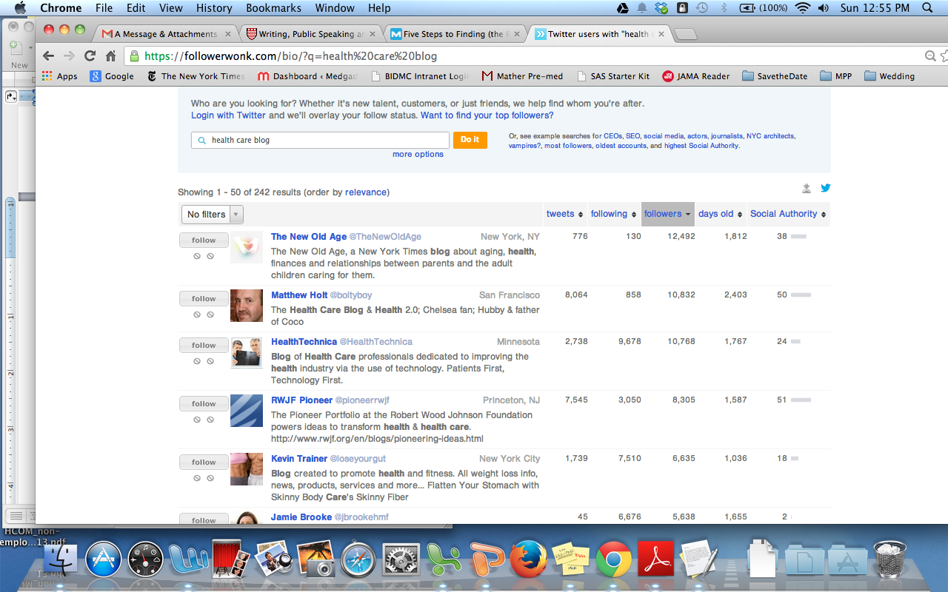
Finding a Guest-Blogging Opportunity
Followerwonk.com
Notes:
Followerwonk, a Twitter search tool, has a set of powerful features for the curious Social Media researcher – in particular the “Search Twitter Bios” and “Analyse Followers” tools which make for rapid identification of real people in a target audience.

Slide 7
Checking Site Authority
OpenSiteExplorer.org
Notes:
You can type the URL of the blog into Open Site Explorer to check their domain authority and link profile. You will certainly be earning a link from this blog, so even if it is nofollow, you want to ensure that you're being associated with a quality site. Not that a low DA is always an indication of a poor blog; some are just new and haven't yet built their authority. You just want to make sure you're building trust and not hurting your reputation, your brand, or your own link profile. In addition to DA, then, you'll want to check their profile:

Slide 8
Engagement
moz.com

Slide 9
Things to include in your blog’s sidebar
Option to subscribe
Category list
Most popular posts
Recent blog posts
Search box
Social media connection options
Calls to action
Notes:
1. Option to Subscribe
Assuming you have remarkable content on your blog, which I know all you HubSpot blog readers do, your readers would be interested in coming back to your blog to read your latest posts. So make it easy for them! Add a subscribe button linking to your RSS feed URL. You can use Feedburner to create this URL from your original RSS feed URL, as Feedburner makes it easy for readers to add your feed to their RSS reader, like Google Reader . Also, make sure to include an email form field to allow users to subscribe via email, so your posts will go straight to their email inbox.
2. Category List
Often called “categories” or “topics,” this is a list that makes it easy for your readers to find content that they are interested in. Most blogging platforms automatically create this list from the categories or tags that you assign it when configuring each blog post. Try not to assign more than 1-3 categories per post, since any more would diminish the usefulness of sorting your content by category.
3. Most Popular Posts
The sidebar is a great place to display your most popular (usually meaning the most highly trafficked) blog posts. This way, readers won’t have to dig through pages and pages of content to find your most remarkable content. It will also peak people’s interests to find out why these posts are the most popular.
4. Recent Blog Posts
Including recent blog posts makes it easy for users who enter your site through a single blog post (rather than the homepage) to navigate to your most recent content. This is a great way to encourage readers to remain on the site and get additional page views.
5. Search Box
A search box makes it easy for your readers to find content based on the keyword or phrase they’re looking for. You can have this in your sidebar, but another popular option is to have the sidebar in your header (like HubSpot’s blog ).
6. Social Media Connection Options
These days, RSS isn’t the only way readers keep tabs on their favorite blogs. Include links to your social media profiles, such as Facebook and Twitter, so that you can provide updates to your readers on sites that they visit each and every day. You can even add a Facebook Like Box (previously called Fan Box), so that users can “like” your fan page without having to leave your blog.
7. Calls-to-Action
Now that you have all this great content and blog traffic, you should include calls-to-actionfor what you want your readers to do next. This is especially useful if this blog is a business blog, as you can include CTAs leading to your landing pages and get leads. Try to make your CTAs as relevant to your blog content as possible. You’ll be able to place the most relevant CTAs within each blog post (usually at the bottom of each post) since you’ll be able to customize this space more easily.

Slide 10
Finding Material/Writing a Post
Do’s
Don’ts
Use Expertise
What do you enjoy?
Be Honest
Write on something new
Use the right tone
Write in short paragraphs
Repost a bunch of links
Assume people don’t pay attention to grammar
Accept anything written on the Internet is gold
Notes:
Easiest step
Every blog has a target audience it's written for. Before you start writing blog posts, determine who your primary and secondary audiences will be. Who will want to read your blog and why? Are they seeking professional information and discussions or fun and laughter? Identify not only your goals for your blog but also your audience's expectations for it. Then decide what tone would be most appropriate for your blog, and write in that tone and style consistently.
Give readers a reason to STAY on your blog, not just to leave it!

Slide 11
Understanding your Audience
Developing your persona
Name: Joanna Title: CMO Company: A small SaaS startup Desires: Rapid growth, increased revenue generation Goals: Drive ROI through social and community building
Who do you want to read your post and why?
Professional information vs. fun and laughter
mox.com
Notes:
Who do YOU like to read?

Slide 12
Ways to Increase Readership
Write frequently!
Submit blog to search engine
Use blogroll and links
Respond to your blog’s comments
Tag/Keyword your posts
Submit your posts to social bookmarking sites
Set up an RSS feed
Use images and name them
Promote popularity by showing number of subscribers
about.com
Notes:
Increases subscribers!
What is RSS?
RSS stands for "Really Simple Syndication". It is a way to easily distribute a list of headlines, update notices, and sometimes content to a wide number of people. It is used by computer programs that organize those headlines and notices for easy reading.
What problem does RSS solve?
Most people are interested in many websites whose content changes on an unpredictable schedule. Examples of such websites are news sites, community and religious organization information pages, product information pages, medical websites, and weblogs. Repeatedly checking each website to see if there is any new content can be very tedious.
Email notification of changes was an early solution to this problem. Unfortunately, when you receive email notifications from multiple websites they are usually disorganized and can get overwhelming, and are often mistaken for spam.
RSS is a better way to be notified of new and changed content. Notifications of changes to multiple websites are handled easily, and the results are presented to you well organized and distinct from email.
How does RSS work?
RSS works by having the website author maintain a list of notifications on their website in a standard way. This list of notifications is called an "RSS Feed". People who are interested in finding out the latest headlines or changes can check this list. Special computer programs called "RSS aggregators" have been developed that automatically access the RSS feeds of websites you care about on your behalf and organize the results for you. (RSS feeds and aggregators are also sometimes called "RSS Channels" and "RSS Readers".)
Producing an RSS feed is very simple and hundreds of thousands of websites now provide this feature, including major news organizations like the New York Times, the BBC, and Reuters, as well as many weblogs.
What information does RSS provide?
RSS provides very basic information to do its notification. It is made up of a list of items presented in order from newest to oldest. Each item usually consists of a simple title describing the item along with a more complete description and a link to a web page with the actual information being described. Sometimes this description is the full information you want to read (such as the content of a weblog post) and sometimes it is just a summary.
For example, the RSS information for headlines on a local news website could contain the following information:

Slide 13
Disseminate your Work!
Social media –facebook, linkedin, twitter, etc.
Guest blogging
Join forums or web rings to share ideas
Add your blog’s URL to email signatures and business cards
Nominate yourself for blog awards
If you write for multiple blogs, then link to them!

Slide 14
Maintaining a Schedule
Content >>> Frequency
Benefits of high-frequency posting
Would you want to buy a newspaper whose articles never changed?
Attracts new visitors/Retains repeat visitors
Search engine optimization
Ensures timeliness
Costs of high-frequency posting
Time – each blog post takes 1 hr
Risk repeating material
Notes:
The same theory applies to blog content. If you don't update your blog with a new post, there is no reason for people to visit. There is nothing new for them to see.
However, if you post new content frequently that is timely and written in a style people enjoy, they are likely to return again and again to see what you have to say. The more frequently you publish new posts, the more new content there is for people to see and the more reason there is for people to visit again and again.
High Blog Posting Frequency Can Attract New Visitors
Not only do new blog posts give people a reason to return to your blog, but they also help your blog in terms of search engine optimization. Each new post is a new entry point for people to find your blog through search engines. The more entry points, the better the chances are that new readers will find your blog.
High Blog Posting Frequency Can Help You Retain Repeat Visitors
Frequent posting helps to attract more visits from people who like your blog and decide to subscribeto it. Each time you publish new content on your blog, your subscribers will either see that post in their feed readers or they'll receive emails directing them to your blog to read the new posts. That means more opportunities to increase traffic to your blog everytime you publish new content.

Slide 15
Posting Frequency relates to growth goals
For maximum growth: post multiple times per day to drive the most traffic (3-5 times or more is considered best for power bloggers).
For steady growth: post at least once per day.
For slower growth: publish at least every 3 days or 2-3 times per week.
For very slow growth: posting less frequently than 2-3 days per week is most appropriate for bloggers who maintain blogs as a hobby with no strategic plans for growth
about.com

Slide 16
Let’s Discuss!
Pair up into groups of 2-4, split by interest
Aim to answer the following questions:
What are 3 blogs that I will look into?
What should the focus of my blogs/posts be?
What are 3 things I can do now to increase my readership?
How will I disseminate my work?
How ofte

